Slide 1
Team 5 Conceptual Design
Dillon Williams
Nidhay Patel
Ryan Reed
Michel Turpeau
Austin Sigg

Slide 2
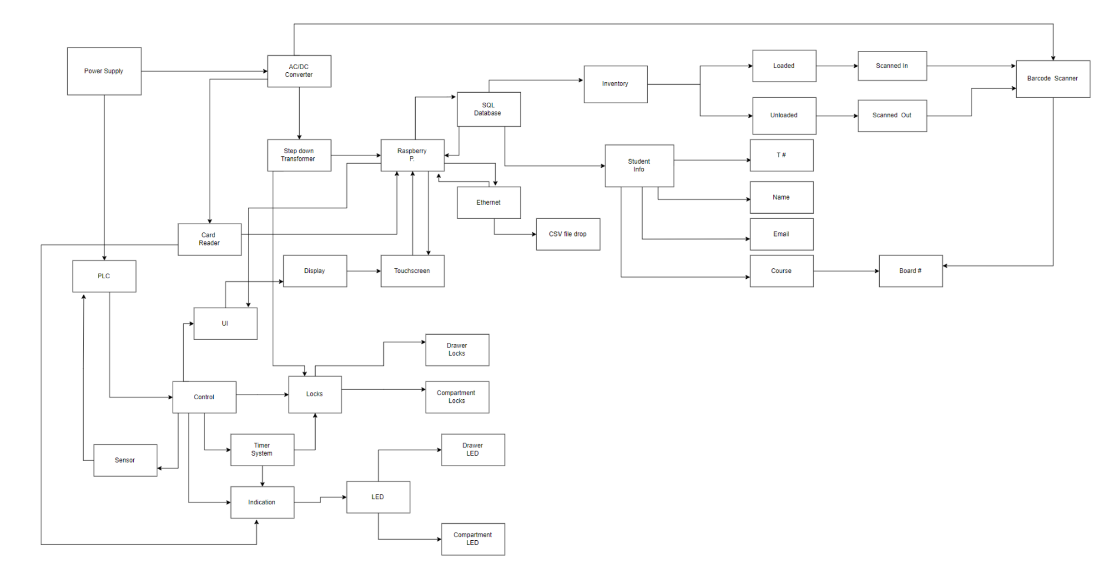

Slide 3
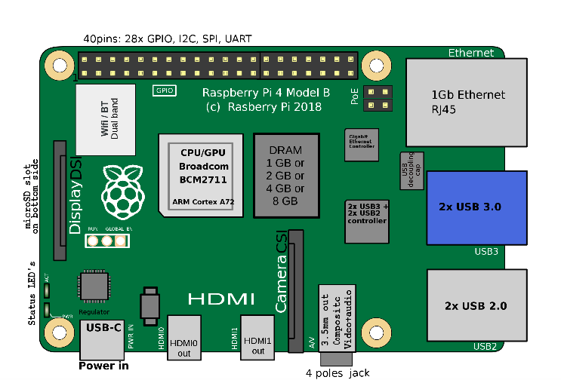

Microcontroller
Raspberry Pi Model 4 B
Card Reader
Input: Signal/Message/Information from Eagle Card
Output: Create Data and signal Microcontroller Unit
UI
Raspberry Pi LCD touchscreen
Input: Information from Student
Output: Raspberry Pi signaling PLC

Slide 4
Pi connections
Raspberry Pi
SQL Database
Touchscreen
Eagle Card Reader
Ethernet

Slide 5
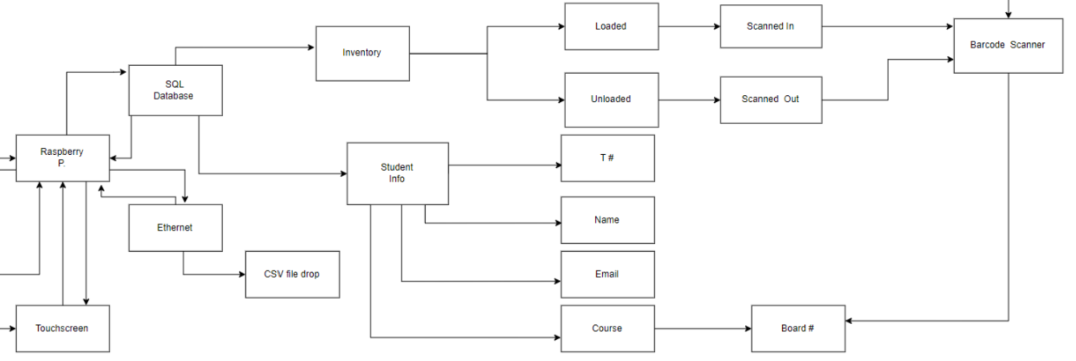
SQL Database
Inventory
Loaded
Unloaded
Student Information
T#
Name
Email
Course & Board#
Ethernet
CSV File

Slide 6
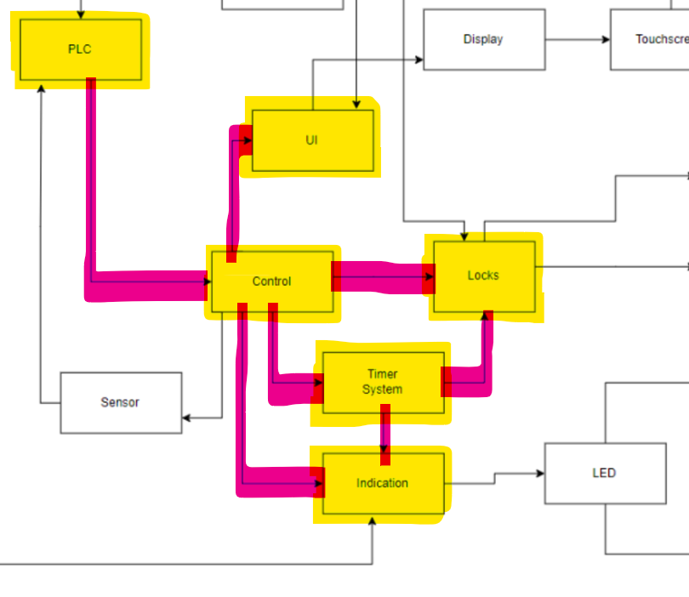
Hardware connections
PLC
HW Control
UI
Locks
Indication
Timer System
Sensors (Addressed later)

Slide 7
Plc / Control
PLC
Powered from wall outlet
Outputs to Control
Control
Hardware control
Outputs to Sensors, UI, Locks, Timer System, Indication System

Slide 8
Hardware subsystems
UI
Communicates with Pi and PLC to create display and store info in database
Locks
Most likely solenoid (Proposed by MechE team)
Powered by DC voltage
Indication System
Most likey LEDs. Will help guide student to correct drawer and compartment
Controlled by PLC
Timer System
Used to flash LEDs and unlock compartments over a predetermined duration
Controlled by PLC

Slide 9
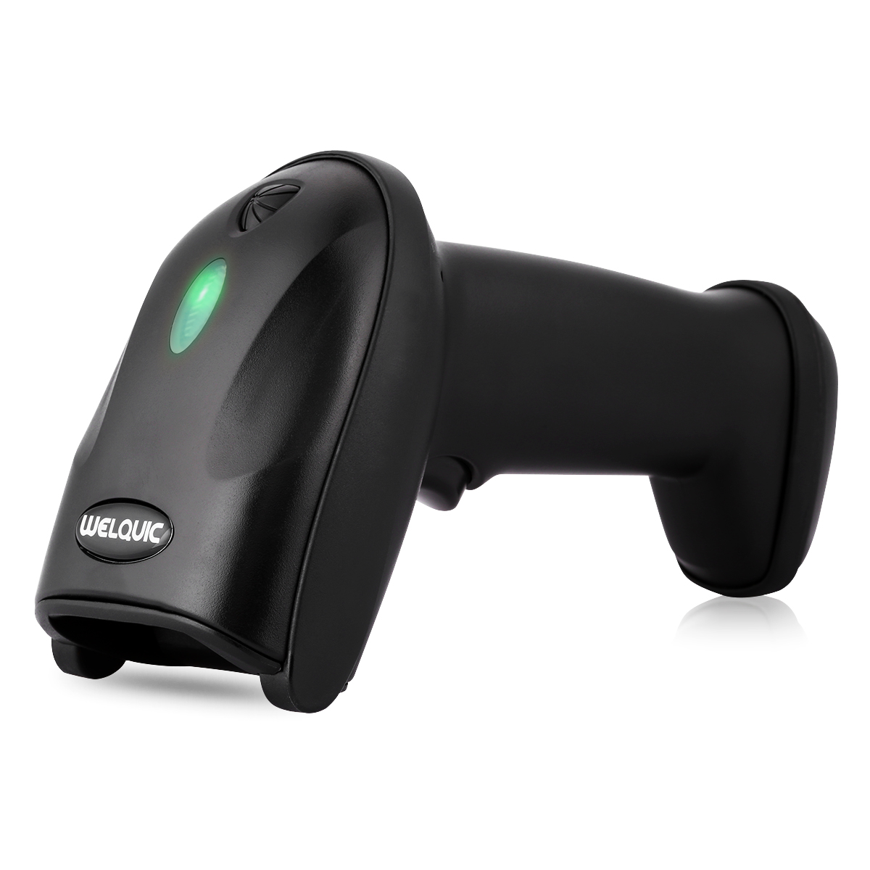
Barcode Scanner
Used to scan in the ID/barcode attached to the device’s box.
Makes it easy to keep track of items have been registered to the database.
Will be used by the operator during the “LOAD” mode.

Slide 10
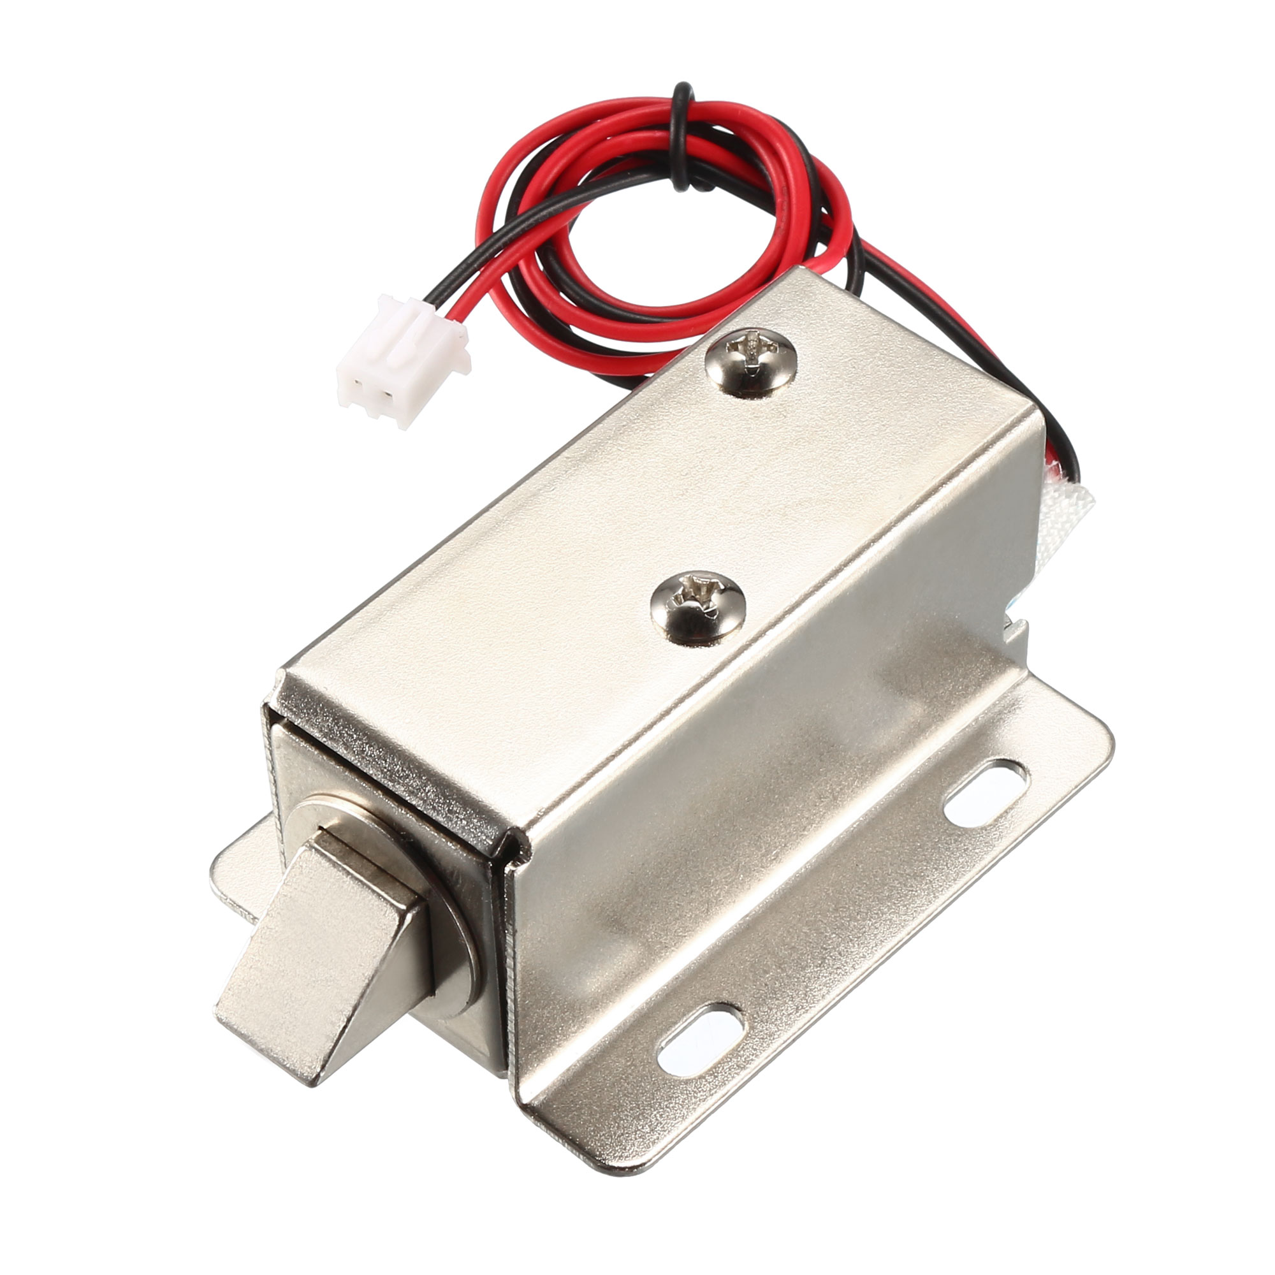
Locks
Main security for the physical system.
Locks for each of the drawer, and for each of the compartments.
The drawers will require more strength, since they are directly exposed and easy to grab a hold of.
Needs to stay lock when power is lost.

Slide 11
LEDs and Indicators
To assist the user, both the operator and the consumer, there will be a series of LED indicators guiding them to the designated compartment.
User Mode (For Consumer):
After successfully completing the rental process the LED will flash, indicating the drawer and the compartment that the item is stored.
Once the item is removed and the compartment and drawer are closed, the LEDs turn off.

Slide 12

LOAD Mode
Mode loading and registering items to the machine.
The machine is aware of empty compartment.
LED indicators will inform the user of the compartment that needs a new item. (The only ones unlocked)
The user CANNOT move on to the next drawer until they have scanned in the device and loaded it into its compartment.

Slide 13
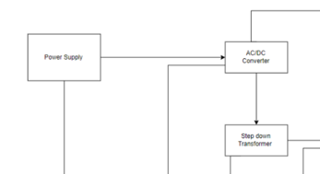
Power
Power Supply
AC/DC Converter
Step Down Transformer
Op-Amp Circuit

Slide 14
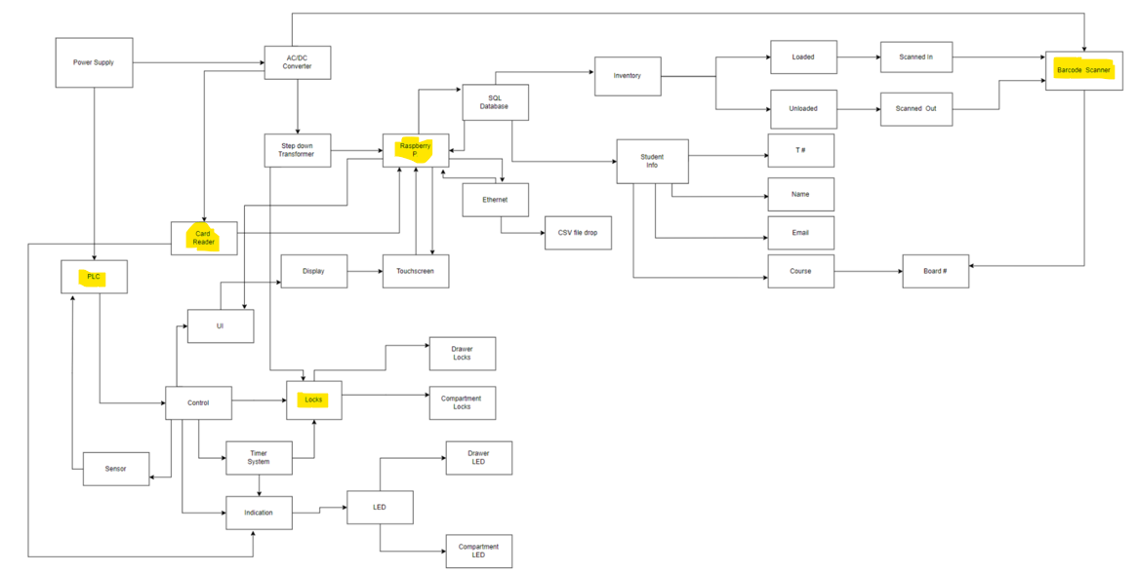
Systems that require Power
Raspberry Pi
Barcode Scanner
PLC
Locks
Card Reader

Slide 15
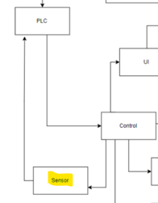
Sensors
To determine stock of each compartment
Considerations:
Photo Eye Light Sensor
Scale Weight Sensor

